Slide 1
Knife Skills Chef John Alunni

Slide 3
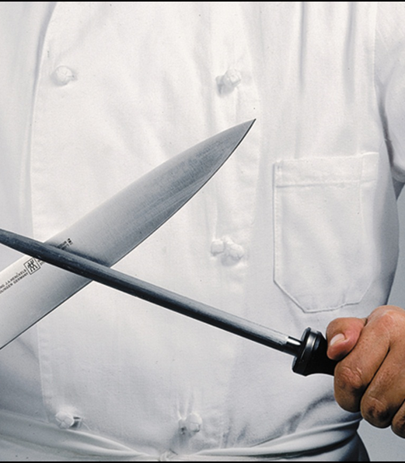
Why are knife skills important?

Slide 4
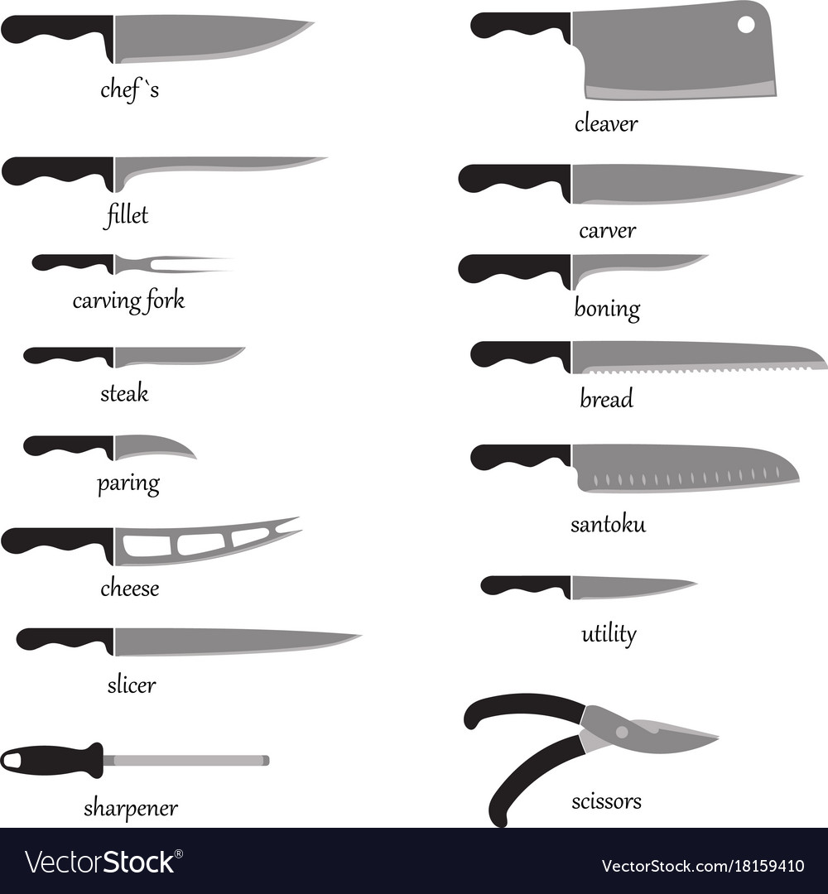
Common Kitchen Knives

Slide 5
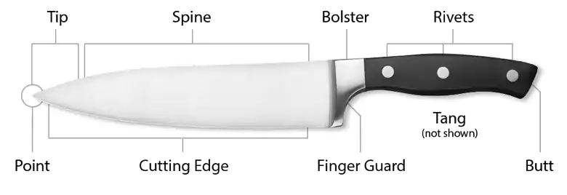
Parts of the knife

Slide 6
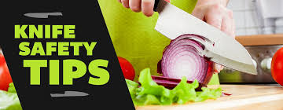
Be Safe!
correct knife for the task
cut away from yourself
clean cutting board
damp towel under cutting board
keep knives sharp
carrying point down, close to leg
don’t catch a falling knife
don’t place knife in sink of water

Slide 7
TIPS FOR YOUR GRIP
The best way? Handling feels safest to you.
A few principles to live by:
• The knife handle shouldn’t be held in a death grip: try to relax hands and wrists and let the blade do the cutting.
• Position all 10 fingers so it’s virtually impossible for the blade to cut them.
• The hand holding the knife should be gripping the blade as well as the handle.
• The knife moves in a rocking motion, from front to back, as well as up and down.
• The knife should be at the same height or just below your elbows, so that the whole upper body, not just the hands, can put downward pressure on the knife.

Slide 8
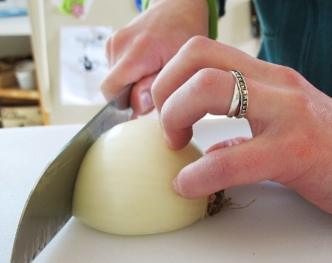
The claw

Slide 9
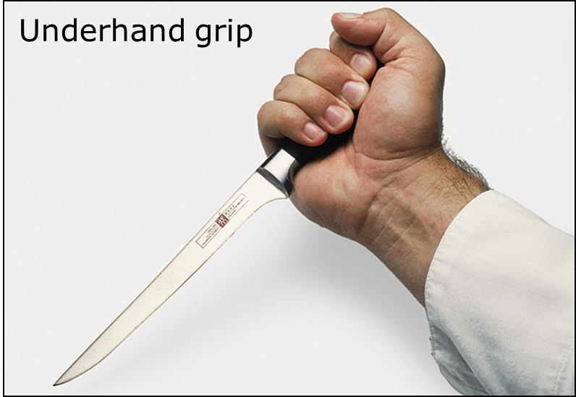
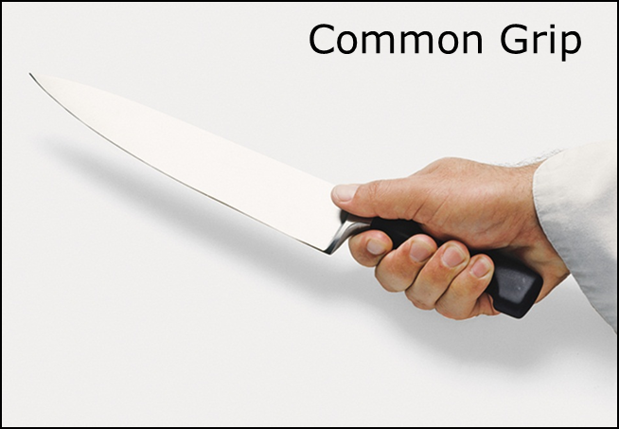
Grips

Slide 10
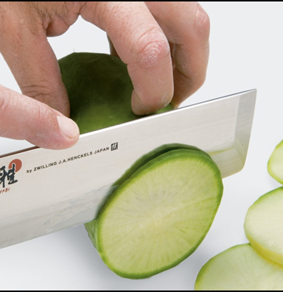
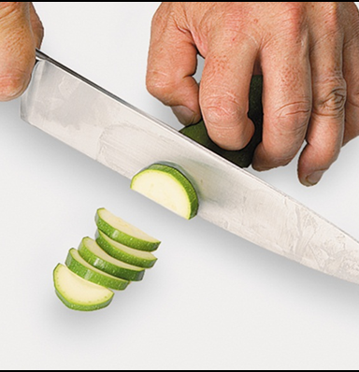
Cutting and hand placement

Slide 11
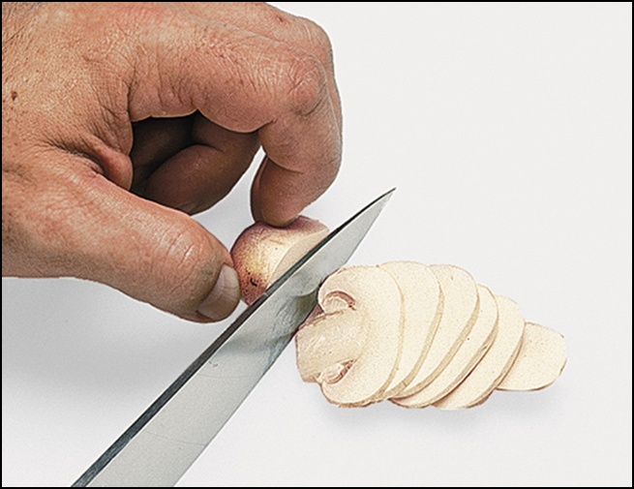
Hand placement

Slide 12
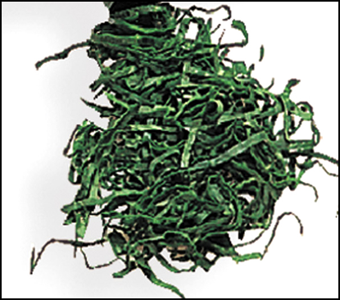
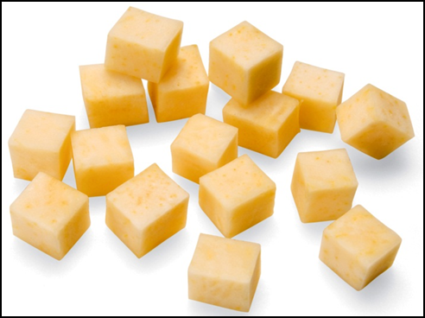
Classic Cuts

Slide 13
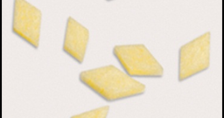
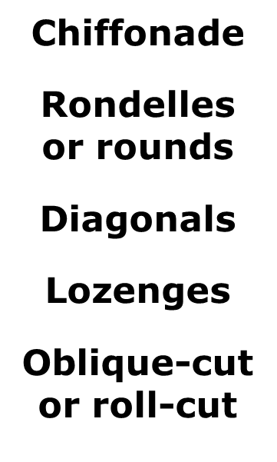
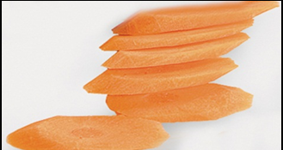
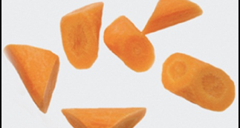
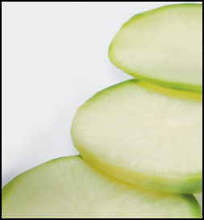
Classic Cuts

Slide 14
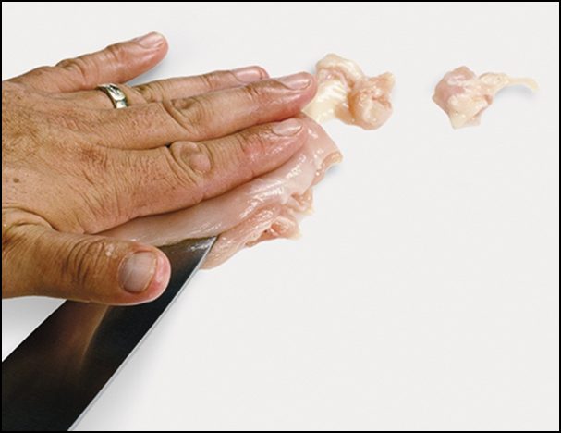
Butterfly

Slide 16
Chopping Parsley

Slide 17
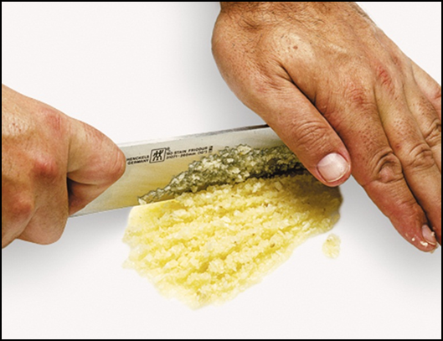
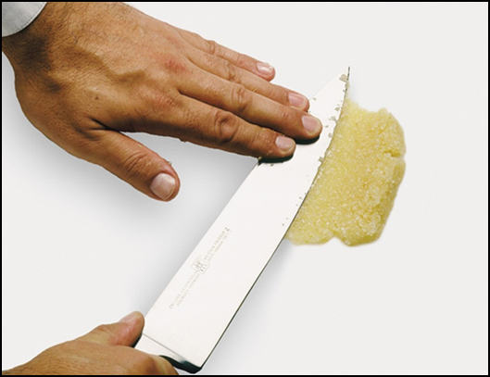
Chopping Garlic

Slide 18
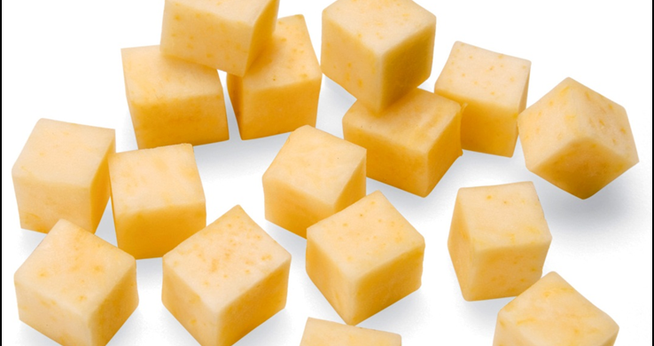
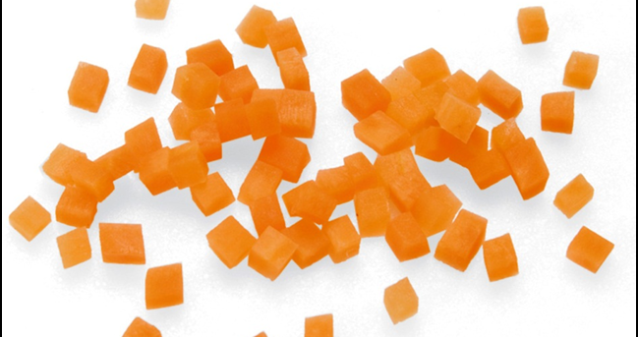
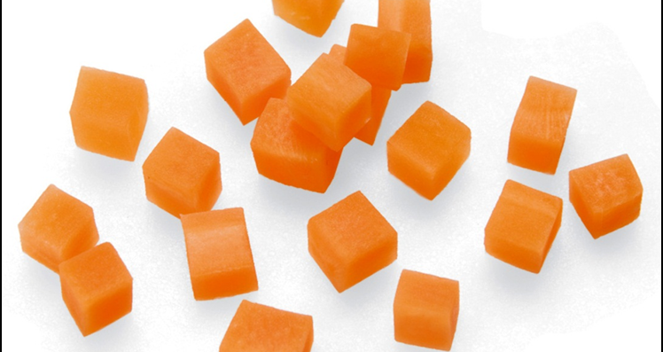
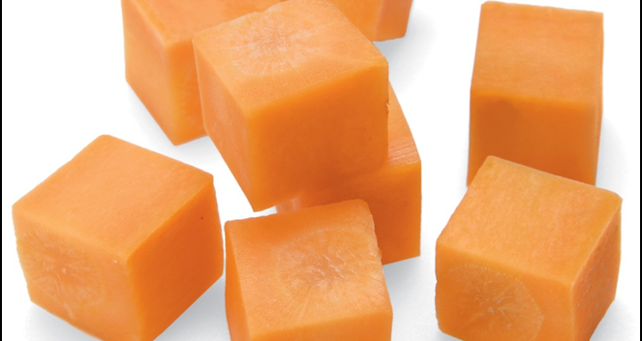
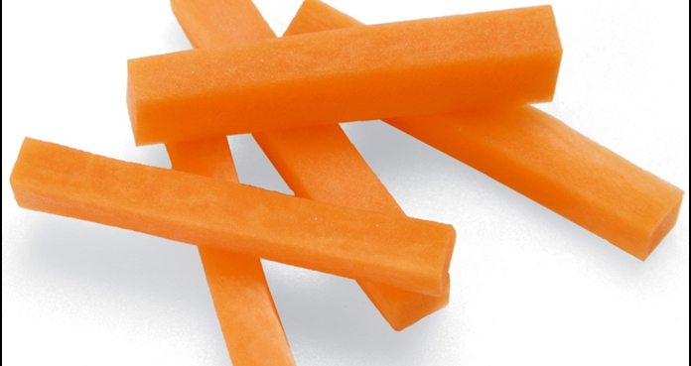
Basic cuts

Slide 19
Paysanne

Slide 20
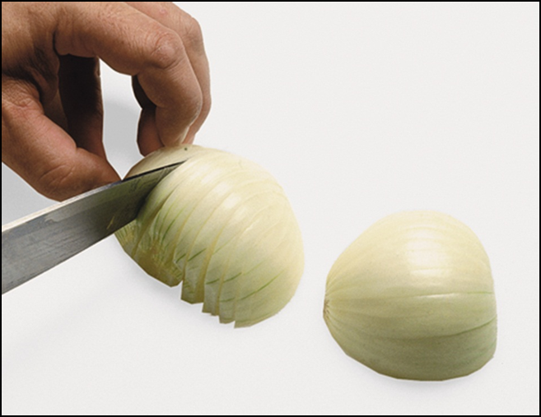
Dicing and onion

Slide 21
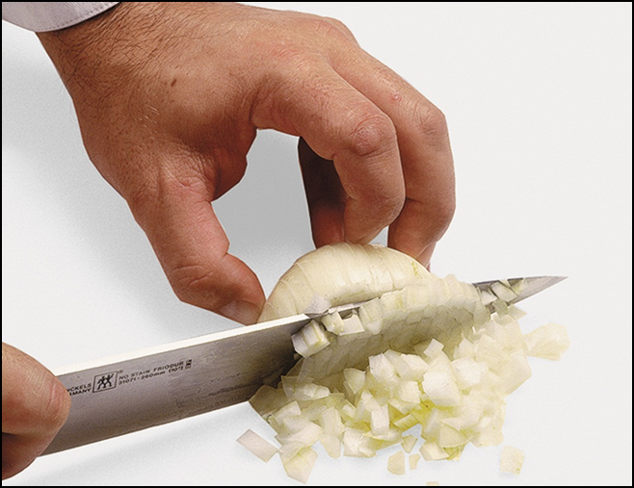
Dicing and onion

Slide 22
Mincing

Slide 23
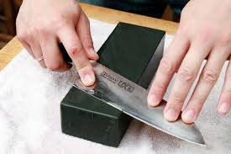
Knife sharpening

Slide 24
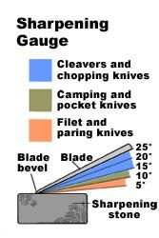
Knife angle guide

Slide 25
Pull Through

Slide 26
Wet/Dry Stone

Slide 27
Diamond Stone

Slide 28
Types of Steels

